Slide 1

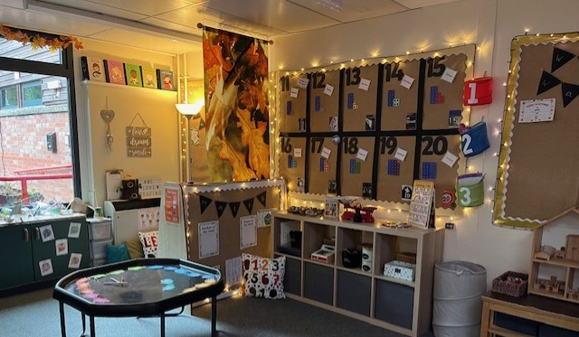
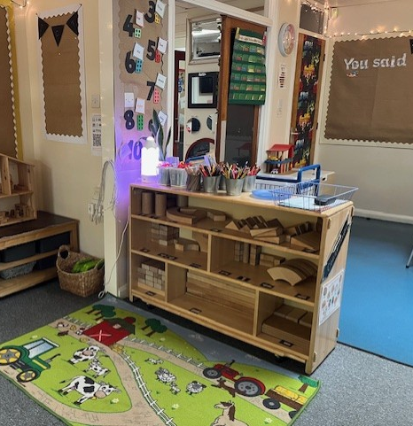
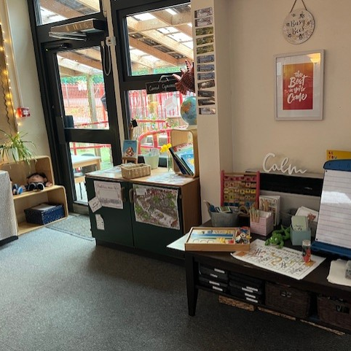
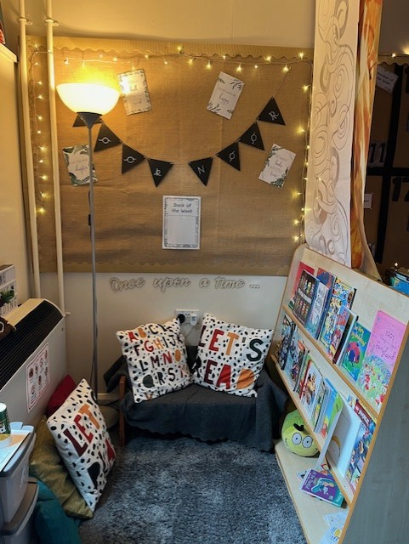

Meet the Teacher Dosbarth Menai

Slide 2

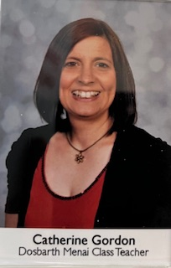
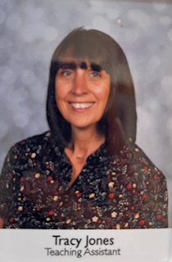
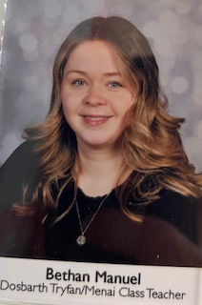
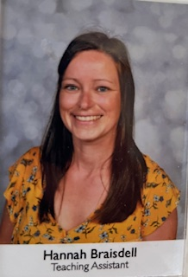
Meet the Teacher – Dosbarth Menai
Mrs Gordon
Mrs Jones
Mrs Manuel
Friday Cover
Mrs Braisdell
PPA Cover Teacher

Slide 3

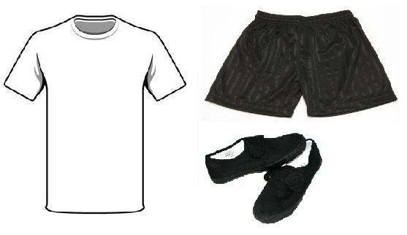
Meet the Teacher – Dosbarth Menai
School Rules
Ready Respectful
Safe Happy
School Uniform and PE kit (clearly labelled with your child’s name)
Further information can be found on the school website under Uniform Policy.
Class Promise –
whole class collaboration
Reading - Your child will be given a reading book or word cards to bring home following our reading session on a Monday which will need to be returned to school the following Monday. Please make time to read little and often, daily if possible.

Slide 4
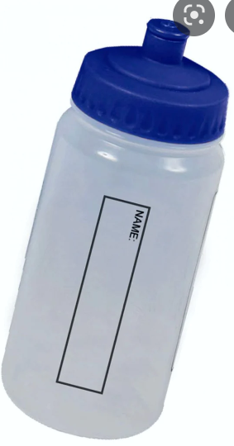
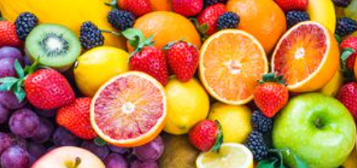

Meet the Teacher – Dosbarth Menai
Healthy Snack is provided as part of our snack scheme, £25 per term – September, January & April/May.
Any additional funds from snack contributions are used for a vast array of resources and experiences outlined in this years snack letter.
Drinks Bottles
It is really important that your child has a drinks bottle in school daily to help them stay hydrated. Please ensure it is clearly labelled.

Slide 5
Meet the Teacher – Homework Grid

Slide 6
Meet the Teacher – Class Timetable

Slide 7
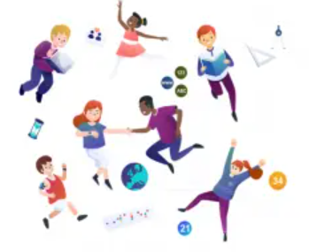
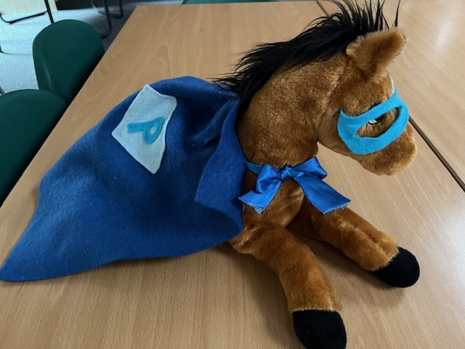
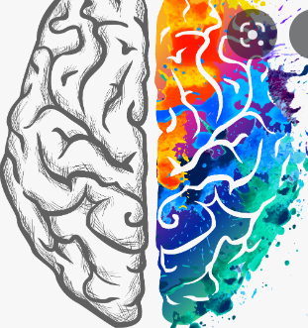


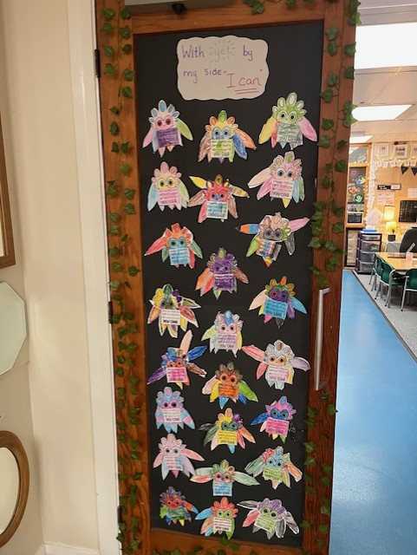



Meet the Teacher – Dosbarth Menai
New Curriculum
Growth Mindset

Slide 8

Meet the Teacher – Dosbarth Menai
How to help your child….. Mathematics
Numbots – Launch day Friday 19th – come to school dressed as a Robot
Numbers 1-20, ordering, formation, addition and subtraction, number bonds, number sequences, number patterns.
Counting on and counting back from different starting points to 100.
Odd and even numbers to 20.
Tens and units.
Doubling & Halving
Solving problems using real life examples e.g. I went to the shop with 20p and bought a comic. It cost me 10p, how much change did I get?
Number names – one, two, three/ ordinal numbers – first, second, third
Count the difference between 10 and 15.
Times tables – children will start to learn their 2’s, 5’, 10’s
Coin recognition and different ways of making 10p, 20p etc..
Measuring – using non standard units i.e hand spans, cubes
Measuring liquids – full, half full, Weighing with grams and kilograms.
Halves and quarters.
Time – seasons, days of the week, months of the year.
Telling the time to the hour and half hour, on both digital and analogue clocks as well as understanding time related vocabulary.
Shape – recognising common 2D shapes. 3D shapes and their properties – ideal shopping activity to keep your child occupied.
Whole turns and half turns, Position, direction & movement.
Always make it practical and fun!

Slide 9
Meet the Teacher – Dosbarth Menai
How to help your child….. Reading/Oracy
Let your child choose the book,
Look at the pictures and talk about what’s going on,
Turn off any distractions,
Keep it short and fun to start with,
Give books as presents,
Visit the library,
Take books with you when you go places,
Don’t panic if they read the same book again and again,
Model an enjoyment of reading – paper/ magazine/ cookbook/ anything.
Utilise digital support – Teachyourmonstertoread app, Oxford owl, Wordshark.
Talk about stories they have heard, about things they have seen, places they have been to, activities they have taken part in.
Conveying messages, information accurately.

Slide 10
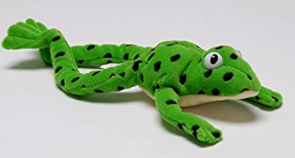
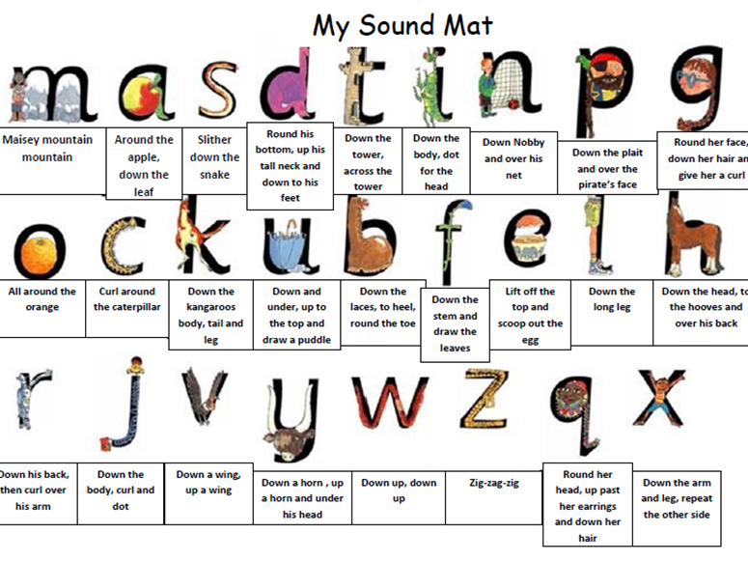
Meet the Teacher – Phonics
How to help your child….Read Write Inc
sh o p
Fred Talk
Special Friends
Fred in your head
Red words

Slide 11


Slide 12
Meet the Teacher – Dosbarth Menai
How to help your child…… become independent Self care
At home practise putting own coat, cardigan or jumper on and taking them off(including zips and turning items back the right way round).
Practise laces (if children come to school with laced shoes)
Practise going to the toilet themselves independently and leave washrooms tidy (toilet flushed, paper towels in bins, taps turned off).
Social/communication
Support children to use basic manners appropriately, saying ‘please’ and ‘thank you’ and ‘excuse me’ when they want to speak to an adult or a peer.
Food/Dining
Practise using a knife and fork at mealtimes.
Practise scraping leftovers into food waste and taking plates/cutlery to the kitchen.

Slide 13

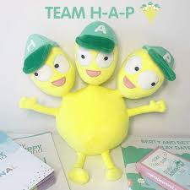

Meet the Teacher – Dosbarth Menai
My Happy Mind is a wellbeing program based around helping children to understand how their brain works and to support them in developing positive skills and habits to be their very best selves!
Children will meet all the characters as we progress through the modules.
Children will learn how their brain works.

Slide 14
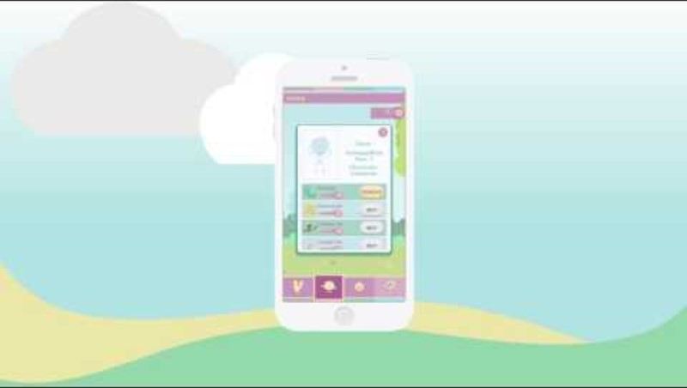
Meet theTeacher Dosbarth Menai
Sign up for the Parent App using our school code: 400428

Slide 15
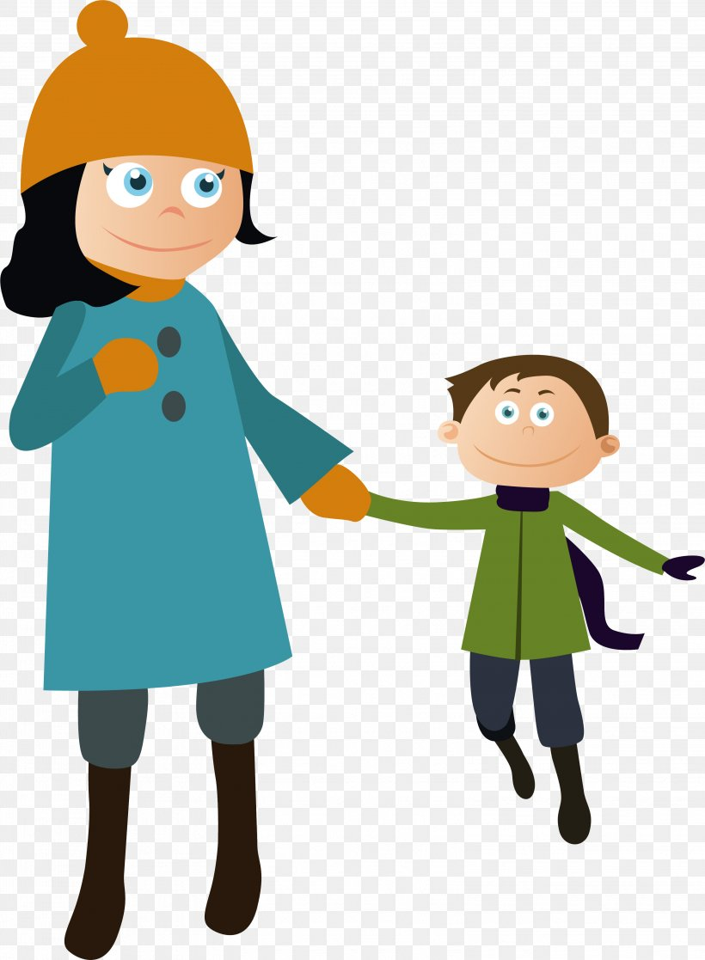

Meet the Teacher – Dosbarth Menai
Communication – regular updates, showcase of work, photographs.
Drop off – 8.50am, gate closes 9am
Pick up – 3pm
Please remember absences and any other important information should be sent via the main office NOT Seesaw.

Slide 16
Meet the Teacher – Dosbarth Menai
Thank you for listening and sparing the time to support your child, Dosbarth Menai and our school community.
If you would like a copy of this evening’s powerpoint please leave your email details on the sign up sheet.

